Slide 1
CampusTrail — All-in-One Campus Travel Hub
E-commerce (Term IV), IIM Kashipur
Prepared by: CampusTrail Project Team
Date: September 07, 2025

Slide 2
Value Proposition + Problem (Set the Hook)
Value Proposition: Campus-only platform to rent travel gear, share itineraries, and find companions—secured by deposits, reviews, and dispute resolution.
Observed Pain: Planning is fragmented across separate tools; coordination fails at handoff/payment steps and identity silos create trust gaps.
Tool Fragmentation: Gear (Bragpacker/SharePal), Companions (Meetup/GAFFL), Itineraries (Itinsy/Stippl/Google Docs).
No Campus Context: Not campus-verified, lack deposit/escrow logic, no hostel pickup workflows or society tie-ins.
Google Scan: No integrated, campus-specific solution; students patch together DIY flows leading to time loss, risk, and drop-offs.
Opportunity: Bundle the full journey with a trust layer and UPI-ready flow tuned for short-haul campus handoffs.

Slide 3
Problem Validation & Insights (Why Now)
Identity Silos: Off-platform IDs → weak accountability and safety in peer exchanges.
No Escrow in Planning Apps: Itinerary/companion tools rarely support deposits or structured disputes.
Operational Friction: Pickup/return steps are unclear, causing no-shows, delays, and damage risk.
Fragmented Reviews: Feedback is scattered; no unified reputation that travels with the student/item.
Campus Specificity Missing: .edu verification, society tie-ins, locker hubs, common pickup windows and governance needs.
India Context: UPI ubiquity + QR literacy + mobile-first usage enables low-friction deposit holds and confirmations.
Conclusion: A verified campus network + deposits significantly improves conversion, safety, and turnaround time.

Slide 4
Competitive Landscape (Category Map & Takeaways)
People-centric: Meetup, GAFFL—open networks, not campus-verified, no gear or deposit flows.
Plan-centric: Itinsy, Stippl, Docs—good itinerary sharing, no transactional handoff to gear or companions.
Gear-centric: Bragpacker, SharePal—robust city-wide rentals, no campus verification, not integrated with companions/itineraries.
Gaps Across Rivals: Campus verification, end-to-end journey coverage, risk controls (deposits, disputes), and local handoffs.
CampusTrail Positioning: Campus-verified + all-in-one + escrow/disputes → top-right of a 2×2 (Verification vs Journey Coverage).
Implication: We reduce search cost, build trust, and keep the entire transaction on-platform.

Slide 5
What Exists vs What’s Missing (and our Answer)
Gear rental → Bragpacker/SharePal; Gap: off-platform identity; campus trust missing → Answer: Verified profiles, deposit lifecycle, reviews.
Itinerary sharing → Itinsy/Stippl/Docs; Gap: no tie-in to campus gear pool → Answer: Itineraries linked to gear + companion matching.
Companions → Meetup/GAFFL; Gap: broad audience, safety/fit concerns → Answer: Campus-only network, interests/style filters.
Payments & risk → Stand-alone payments; Gap: no deposit logic, weak recourse → Answer: Hold → capture/release + dispute outcomes.
Bottom Line: CampusTrail creates a single, trusted context for planning, people, gear, and payments.

Slide 6
Solution Overview (All-in-One)
Gear Rentals: Buffer-aware availability (DAY/PARTIAL), deposit holds, QR/OTP pickup & return, inspection outcomes and receipts.
Itinerary Sharing: Interests/style, capacity with approvals, match scoring to companion requests; shared gear cart linkage.
Companion Matching: Verified campus profiles, safety cues, host approvals; messaging/notifications next.
Trust Layer: Polymorphic reviews (gear/itinerary/user/companion), simple disputes with evidence and policy matrix, exportable audit logs.
Security & Auth: OTP → JWT, rate limits, minimal PII, optional MSSQL event logging for audits.
Payments Ready: UPI-ready flows; gateway integration next for real deposit holds and invoices.

Slide 7
Why Campus-Only Wins (Moats & Economics)
Trust Moat: .edu verification and repeated interactions in a known community reduce moral hazard and disputes.
Liquidity Density: Campus concentration shortens time-to-match and increases on-time pickups/returns.
Operational Advantage: Short-haul handoffs, hostel locker hubs, and slotting windows lower logistics friction.
Convenience Stack: Single profile/wallet/deposit/chat reduces drop-offs and improves conversion.
Reputation Flywheel: Reviews across people, items, itineraries increase counterpart reliability over time.
Unit Economics: Higher GMV/user as density grows; lower CAC via ambassadors/referrals; deposits reduce loss rates.

Slide 8
Product Modules: Now / Next / Later
Now (MVP live): Gear marketplace; itineraries; companions; orders snapshot; polymorphic reviews; disputes scaffold; OTP→JWT; optional MSSQL logs.
Next (V1.1–1.2): Dispute timeline UI; Orders in profile; review filters/caching; file uploads; Postgres migration; normalized errors & pagination; PWA polish.
Later: Payment gateway for real holds (UPI/cards); messaging/notifications; recommendations; reputation score; locker hubs; admin dashboards; insurance add-ons.
Design Principles: TypeScript-first, Zod validation, mobile-first flows, auditable events, and documented runbooks.

Slide 9
Architecture (High-Level; Built for Evolution)
Frontend: React 18 + Vite, TypeScript, Tailwind, Framer Motion; PWA enhancements planned.
Backend: Node.js + Express (TypeScript); Zod for schema validation; idempotency patterns for payments (planned).
Data Layer: Prisma ORM; SQLite (dev) → Postgres (prod); optional MSSQL event log with timeout-safe disable flag.
Auth & Security: Email OTP → JWT; rate limits; minimal PII; audit logs; least-privilege principles.
Observability: Health endpoints; analytics events; Sentry/PostHog planned; error envelope normalization across APIs.
Integrations: Payment gateway (hold/capture/release), S3/Blob storage for photos, notification bus later.

Slide 10
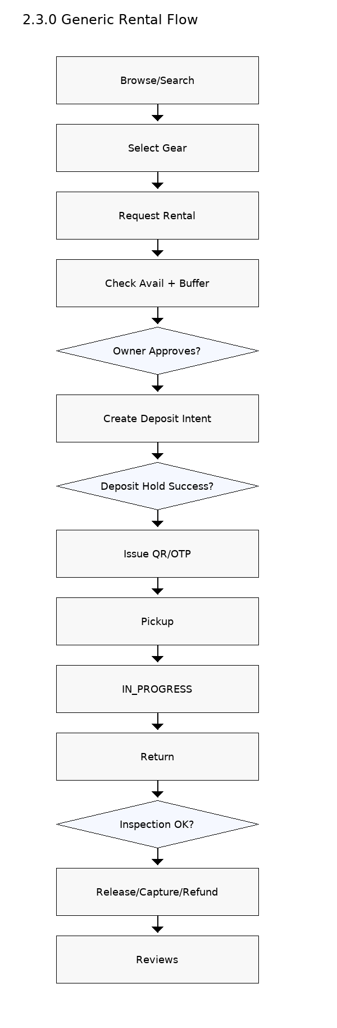
Core User Journey — Generic Rental (Vertical Diagram)
Steps: Browse → Request → Approve → Deposit Hold (UPI) → QR/OTP Pickup → Return → Inspection → Release/Capture → Reviews.
Buffer Logic: DAY/PARTIAL modes add guard bands to prevent overlapping rentals and allow turnaround time.
Controls: Deposit as pre-pickup gate; QR/OTP chain-of-custody; inspection drives financial outcome and receipts.
Outcomes: Faster, safer rentals; lower dispute rates; reputation accrues to both renter and lender.

Slide 11
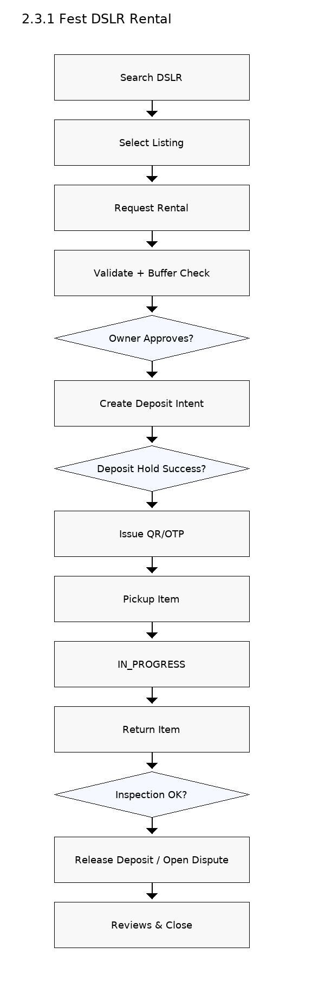
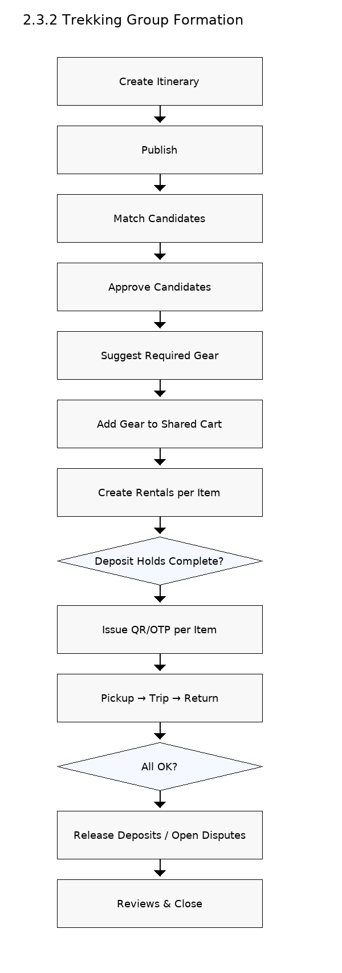
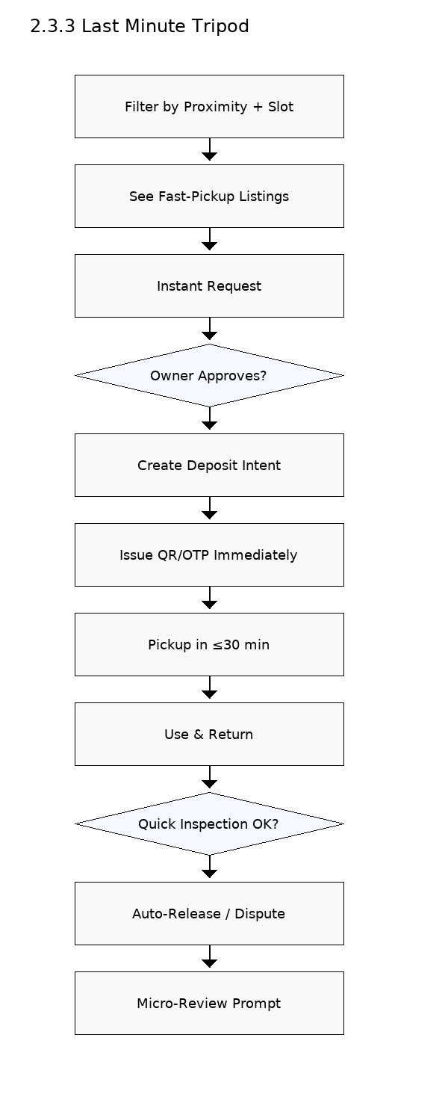
Use Cases (Tangible Wins)
Fest DSLR Rental: Time-sensitive approvals; high deposit; QR pickup at media room; return inspection; mutual reviews; partial capture if needed.
Trekking Group Formation: Host itinerary; match candidates; shared gear cart; per-item rentals to multiple lenders; synchronized pickups/returns; multi-entity reviews.
Last-Minute Tripod: Proximity + slot filter; instant approval; ≤30-min pickup; auto-release on OK return; micro-review nudges.

Slide 12
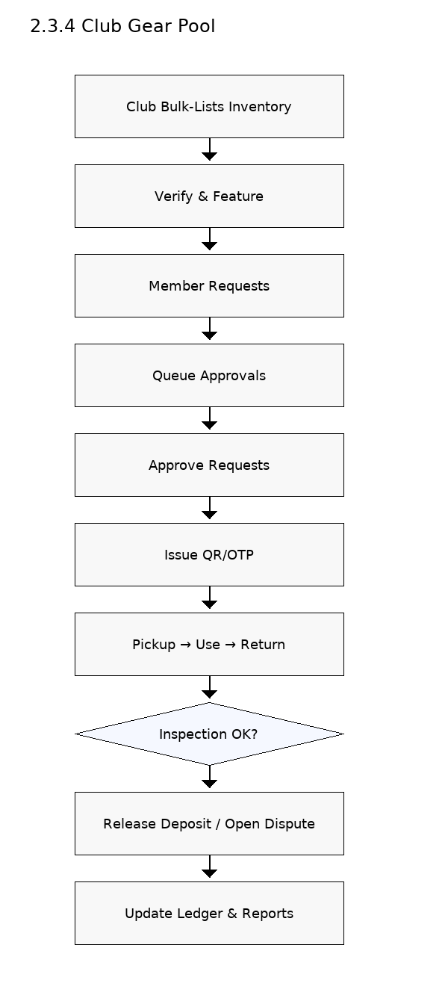
Clubs & Campus Admin (Inventory + Governance)
Club Gear Pool: Verified club profile; bulk listings; approvals queue; QR/OTP handoffs; utilization and on-time dashboards; monthly ledger export.
Locker Pilot: Hostel/common-area lockers with access control and audit logs to reduce coordination overhead and loss.
Admin View (future): Escalation visibility; policy compliance checks; safety reporting; co-branded programs and dashboards.
Benefits: Lower gear loss; higher utilization; transparent governance; reduced staff time and manual tracking.

Slide 13
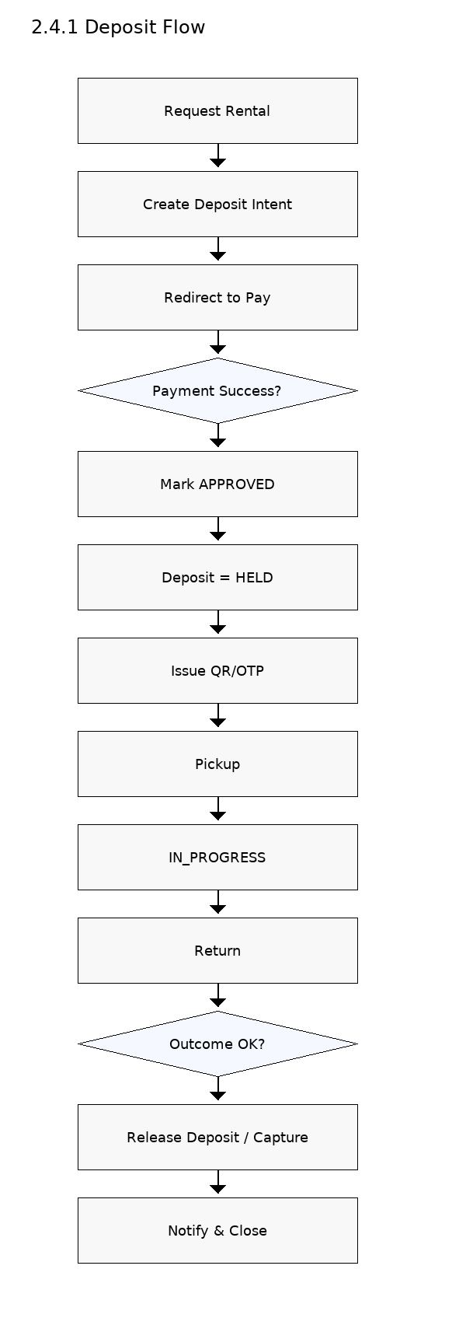
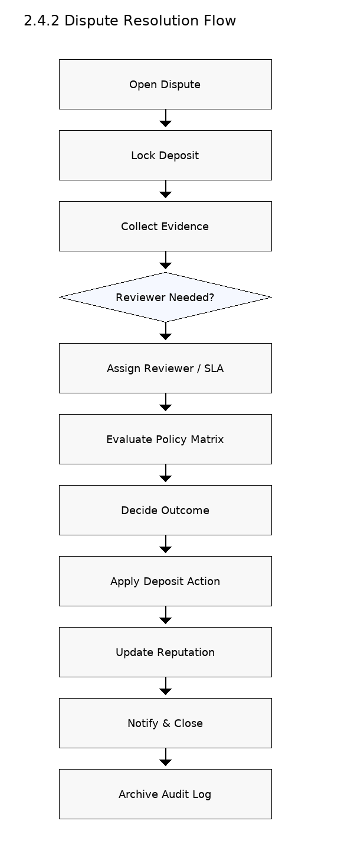
Trust & Safety (Deposits + Disputes + Reputation)
Deposit Lifecycle: Hold at pickup; release if OK; partial/full capture based on damage policy; refunds and receipts generated.
Disputes: Evidence upload by both sides; optional reviewer with SLA; decisions: release/partial/full; audit trail retained for accountability.
Reputation: Polymorphic reviews across users, items, itineraries; planned reputation score blends reviews, dispute outcomes, and on-time rates.
Policy Center: Late/no-show handling; cancellation windows; condition templates; evidence checklists; clear guidance to reduce avoidable disputes.

Slide 14
Business Model, Early Proof & Economics
Business Model (draft): 8–12% take-rate on rental fee (never on deposit). Future premiums: featured listings, club partnerships, locker access, insurance add-ons, admin dashboards.
Early Proof (MVP): Backend + React/Tailwind working; domains live—gear marketplace, itineraries, companions, reviews, disputes scaffold, orders snapshot, OTP→JWT, toasts.
Next Builds: Full dispute management UI, Orders in profile, review filtering/caching, gateway integration for real deposit holds and receipts.
North Star Metric: Completed rentals per active month. Supporting KPIs: GMV, take-rate, request→paid %, on-time returns, dispute rate, match rate, retention, CAC (ambassadors/referrals).
Unit Economics: Density + trust lift conversion and repeat; deposits reduce loss; referrals lower CAC over time.

Slide 15
Go-to-Market, Adoption Tactics & Measurement
Supply Seeding: 10–15 ambassadors; club MoUs; featured lister badges; fee holidays for early inventory.
Channels: In-class demos; fest pop-ups; Instagram/WhatsApp reels; referral credits; UTM-tracked content; society newsletters.
Messaging: “One app for gear, plans, and people—campus-verified and deposit-protected.”
Adoption UX: Mobile-first PWA; UPI checkout; QR at pickup; concise policy tooltips; friction logging and iteration.
Measurement: Views → Requests → Approvals → Deposit Holds → Pickups → Returns; time-to-first-match; repeat renter %; NPS; K-factor.

Slide 16
Risks, Mitigations & 24-Month Timeline (−12 → +12)
Risks: Cold start (low density), trust/safety (fraud, damage, no-shows), ops (SLA breaches, gateway downtime), regulatory (GST, grievance, privacy).
Mitigations: Ambassadors, club tie-ups, fee holidays; deposits, QR/OTP chain-of-custody, evidence-based disputes; runbooks and SLAs (6h/24h); timeout-safe logging and retries; clear ToS and MoUs.
Pre-Launch (T−12 → −1): Discovery, MVP, alpha, beta hardening, go/no-go checklist with readiness at 100%.
Post-Launch (T0 → T+12): Payments live; messaging/notifications; recommendations v1; reputation v1; locker pilot; Postgres cut-over; campus #2 rollout.
Milestones: T+3 GMV ₹1–1.5L/mo; request→paid ≥25%; disputes ≤2%. T+12 GMV ₹5L+/mo; 2 campuses; NPS ≥45; dispute loss <0.7% GMV.

Slide 17
Appendix: Competitive Summary (Quick Reference)
Meetup/GAFFL (People): Great discovery; not campus-verified; no gear or deposit logic; safety/fit concerns persist.
Itinsy/Stippl/Docs (Plans): Rich itineraries; no transactional handoff; no connection to real campus gear or companions.
Bragpacker/SharePal (Gear): Reliable city-wide rentals; not integrated with itineraries/companions; no campus verification or deposit portability.
CampusTrail (All-in-One): Campus-verified; deposits & disputes; integrated journeys; local handoffs (QR/OTP, lockers); unified reputation and audit logs.

